Slide 1
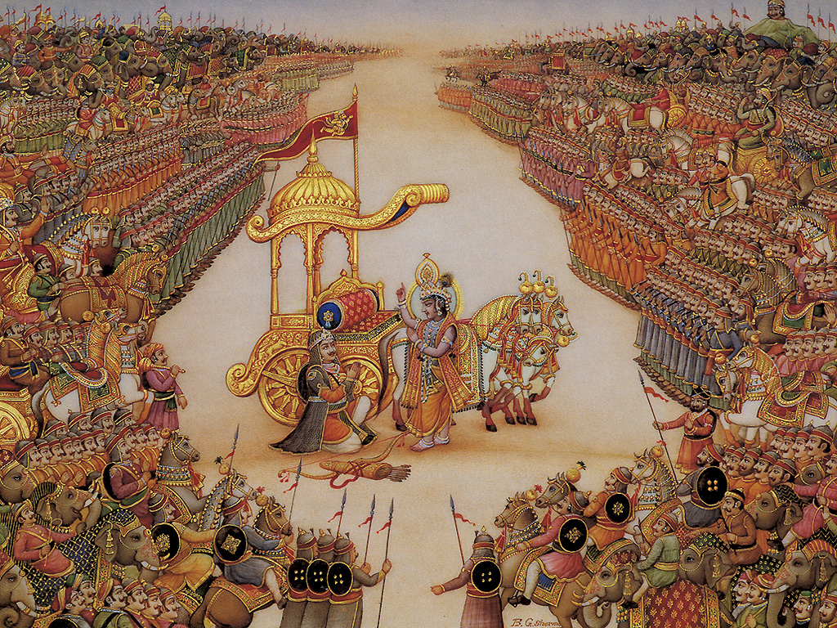
Certificate of Completion
This is to Certify that
Hailey Benton
के अभाव में
Killer Dessert
Cholada Cheerleader
Those Who Speak Don’t Know, Those Who Know Don’t Speak
has successfully completed all requirements of
Asian Great Books
Pepperdine University
April 26, 2019
Don Thompson
_____________________

Slide 2
Certificate of Completion
This is to Certify that
Daniel Kumar Busi
History Buff
Haiku Natural
Spiritual Guru
has successfully completed all requirements of
Asian Great Books
Pepperdine University
April 26, 2019
Don Thompson
_____________________

Slide 3
Certificate of Completion
This is to Certify that
Madison Field
Meditation Master
I dreamt I was a butterfly who was dreaming
about Madison who dreamt she was Chuang Tzu floating
past Stauffer Chapel in Christian’s dream at the Wedding
has successfully completed all requirements of
Asian Great Books
Pepperdine University
April 26, 2019
Don Thompson
_____________________

Slide 4
Certificate of Completion
This is to Certify that
Bela Garcia-Arce
Run, Bela, Run!
Inca Trail? Got it!
Haiku? Got it!
Gateless Gate? Bela awakens in Nirvana
has successfully completed all requirements of
Asian Great Books
Pepperdine University
April 26, 2019
Don Thompson
_____________________

Slide 5
Certificate of Completion
This is to Certify that
Marlee Hewitt
cAnAdA
Brahma’s Biochemist
Genji? Let Him stay on Suma!
Haiku/Calligraphy/Ikebana Artist
has successfully completed all requirements of
Asian Great Books
Pepperdine University
April 26, 2019
Don Thompson
_____________________

Slide 6
Certificate of Completion
This is to Certify that
Sydney Jones
That’s DR. JONES!
Avatar for Arjuna
Gateless Gatekeeper
Genji Zenji!
Great Books Fan!
has successfully completed all requirements of
Asian Great Books
Pepperdine University
April 26, 2019
Don Thompson
_____________________

Slide 7
Certificate of Completion
This is to Certify that
Chantal Laing
One Visual – Purple Silks
Every Day is Taco Tuesday
Deep Thinker – Koan Krusher
Career Pie Baker
has successfully completed all requirements of
Asian Great Books
Pepperdine University
April 26, 2019
Don Thompson
_____________________

Slide 8
Certificate of Completion
This is to Certify that
Tommy Le
Make that Hilfiger!
Chopsticks are Easy – See?!
Our Own Buddhist Monk
Convo Haiku
has successfully completed all requirements of
Asian Great Books
Pepperdine University
April 26, 2019
Don Thompson
_____________________

Slide 9
Certificate of Completion
This is to Certify that
Madalyn Roh
Side Out Maddy!
Nature is Everything
Beach Day Every Day
Wanna Hug My Ikebana?
has successfully completed all requirements of
Asian Great Books
Pepperdine University
April 26, 2019
Don Thompson
_____________________

